Slide 1


CHANNABASAVESHWARA INSTITUTE OF TECHNOLOGY
(Affiliated to VTU, Belagavi & Approved by AICTE, New Delhi) (NAAC Accredited & ISO 9001:2015 certified institution) NH 206 (B H Road), Gubbi, Tumkur - 572216
Department of Information Science and Engineering
2022-23
Project Presentation
On
“TOPIC MODELLING USING NLP”
PRESENTED BY:
AKASH B N [1CG19IS003]
MAHESHA R [1CG19IS030]
VINAY J [1CG19IS058]
YASHAS T R [1CG19IS059]
GUIDED BY:
Mr. Pradeep M Mtech
Assistant Professor
Department Of ISE
CIT, GUBBI

Slide 2
CONTENTS:
INTRODUCTION
PROBLEM STATEMENT
OBJECTIVES
LITERATURE SURVEY
SCOPE OF THE PROJECT
PROJECT METHODOLOGY
RESULTS AND DISCUSSION
CONCLUSION
REFERENCES

Slide 3
INTRODUCTION
Topic modeling using NLP is a technique that uses algorithms to automatically discover latent topics or themes in a collection of text data.
A corpus is a collection of authentic text or audio organized into datasets. 'Authentic' in this case means text written or audio spoken by a native of the language or dialect.
In natural language processing, Latent Dirichlet Allocation is a generative statistical model that explains a set of observations through unobserved groups, and each group explains why some parts of the data are similar.

Slide 4
PROBLEM STATEMENT:
To develop an algorithm or model that can effectively identify and extract the hidden topics or themes from a large corpus of text data, and represent them in a meaningful ways.

Slide 5
OBJECTIVES:
Discover topics in a document or corpus of documents.
Identify relationships between the topics in a corpus.
Extract information from a corpus of documents by summarizing them.
Group documents according to their topics.
Generate new topics to better organize documents.

Slide 6
LITERATURE SURVEY
SL.NO | TITLE | AUTHOR | PUBLISHED ON | REMARK
01 | The Handbook of Topic Models: Algorithms, Applications and Tools | Xu, Zhang and Ma | 2019 | The Handbook of Topic Models provides an authoritative, comprehensive, and up-to-date overview of the field of topic modeling.
02 | Text Mining: A Comprehensive Guide for Practitioners | Guntzer et al | 2019 | Text mining is the process of extracting meaningful information from large amounts of unstructured text.

Slide 7
LITERATURE SURVEY
SL.NO | TITLE | AUTHOR | PUBLISHED ON | REMARK
03 | Introduction to Information Retrieval | Manning, Raghavan and Schutze | 2008 | Information retrieval is the process of finding information from a collection of resources. It is the science of searching for information in documents, databases, and other sources.
04 | Mining of Massive Datasets | Mining of Massive Datasets | 2014 | Massive data mining is a term used to describe the process of extracting valuable and useful patterns from large data sets.

Slide 8
SCOPE OF THE PROJECT :
To uncover and extract key themes or topics from a given text corpus.
This includes preprocessing the text data by removing noise, such as stopwords, punctuation, and special characters, and performing tokenization to split the text into individual words or phrases.
It involves applying a suitable topic modeling algorithm, such as Latent Dirichlet Allocation (LDA) to identify latent topics within the text corpus.

Slide 9
PROJECT METHODOLOGY:
LOAD DATA
TOKENIZATION AND STEMMING
TERM FREQUENCY-INVERSE DOCUMENT FREQUENCY
K-MEANS CLUSTERING
TOPIC MODELLING-LATENT DIRICHIENT ALLOCATION

Slide 10
PROJECT METHODOLOGY:
K-MEANS CLUSTERING ALGORITHM:
1.The first step is to select k no. of the cluster.
2.As centroids, pick k random no. of points from the given data.
3.Allocate all points to the closest cluster centroid.
4.Determine again the centroids of the newly generated clusters.
5.Repeat steps 3 and 4.

Slide 11
RESULTS
Cluster/topic interpretation
Cluster/topic visualization
Performance evaluation
Applications

Slide 12
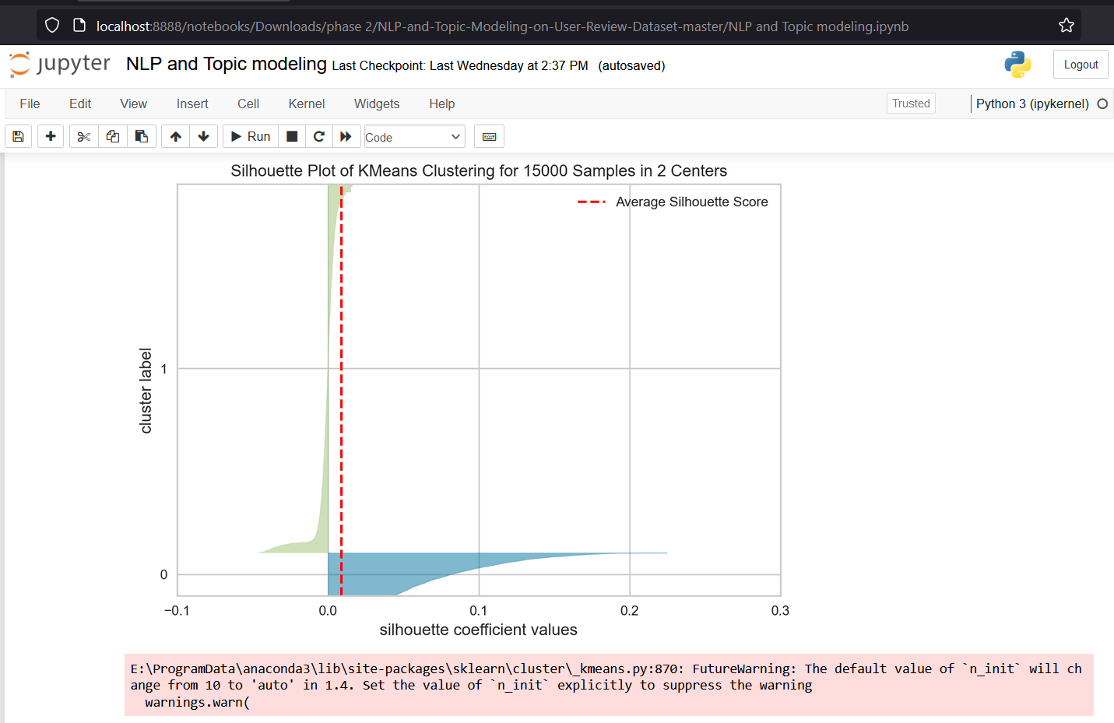

Slide 13
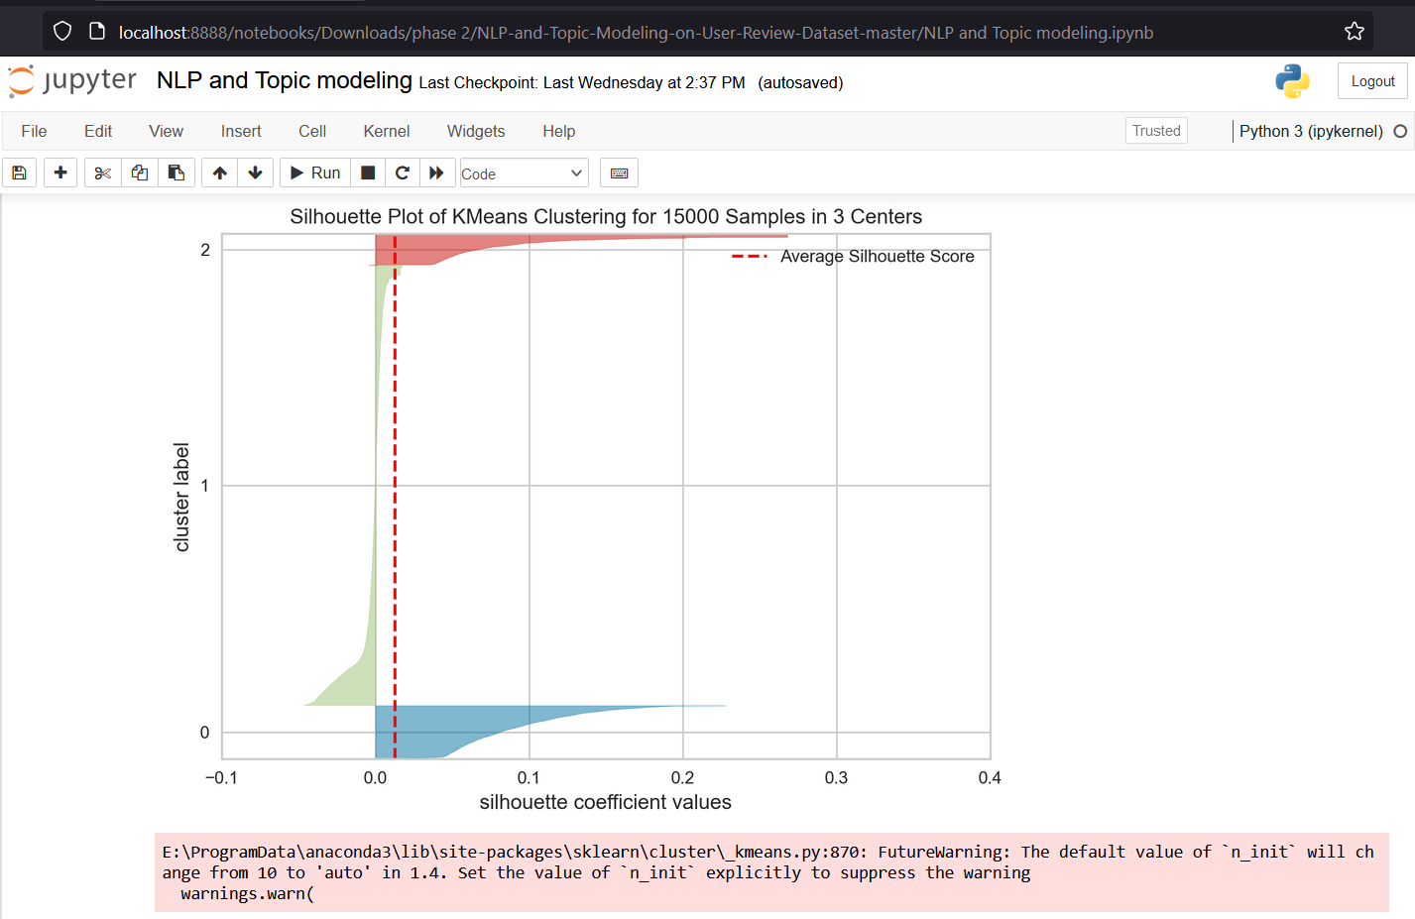

Slide 14
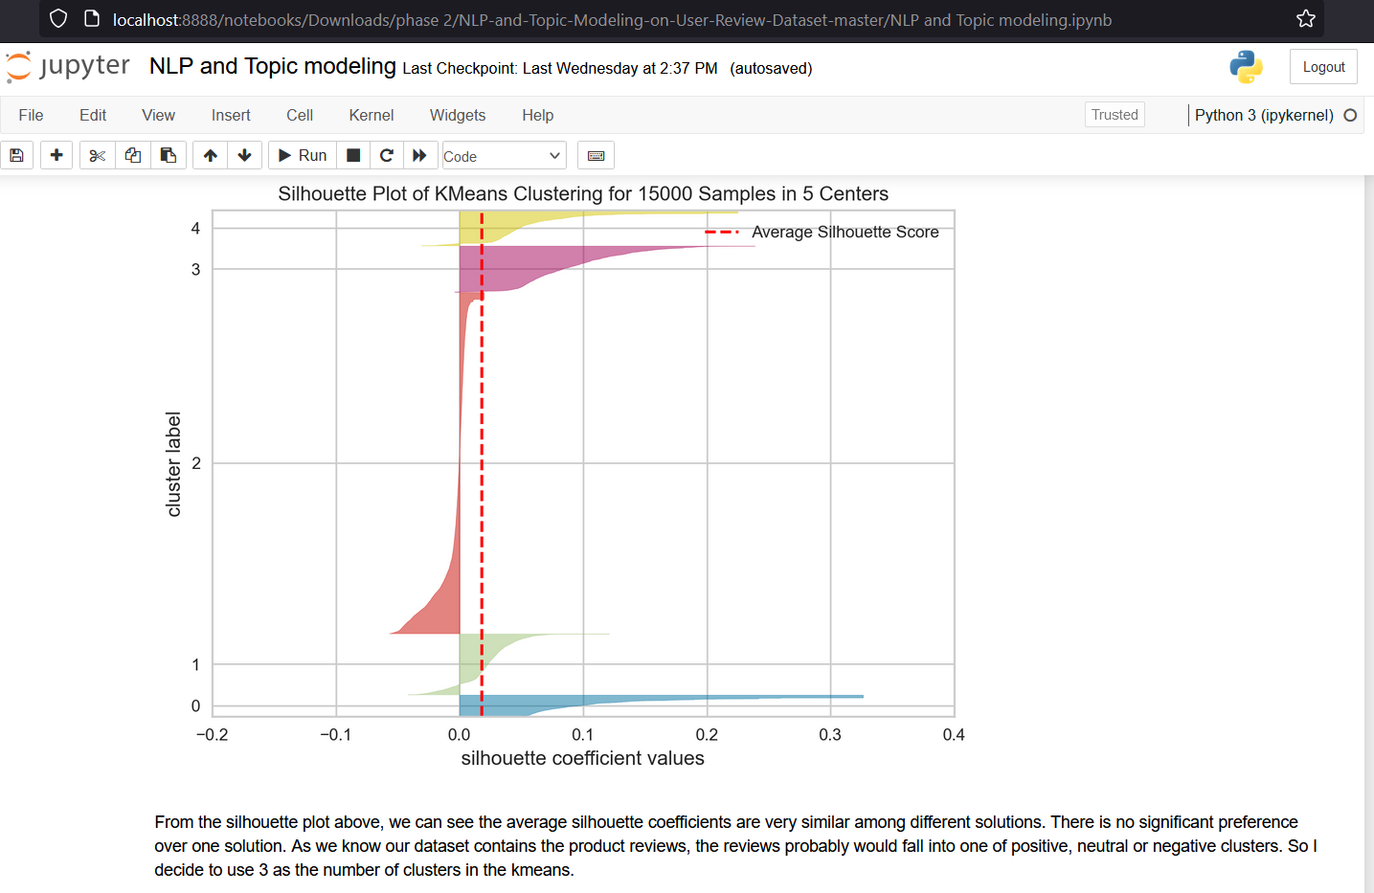

Slide 15
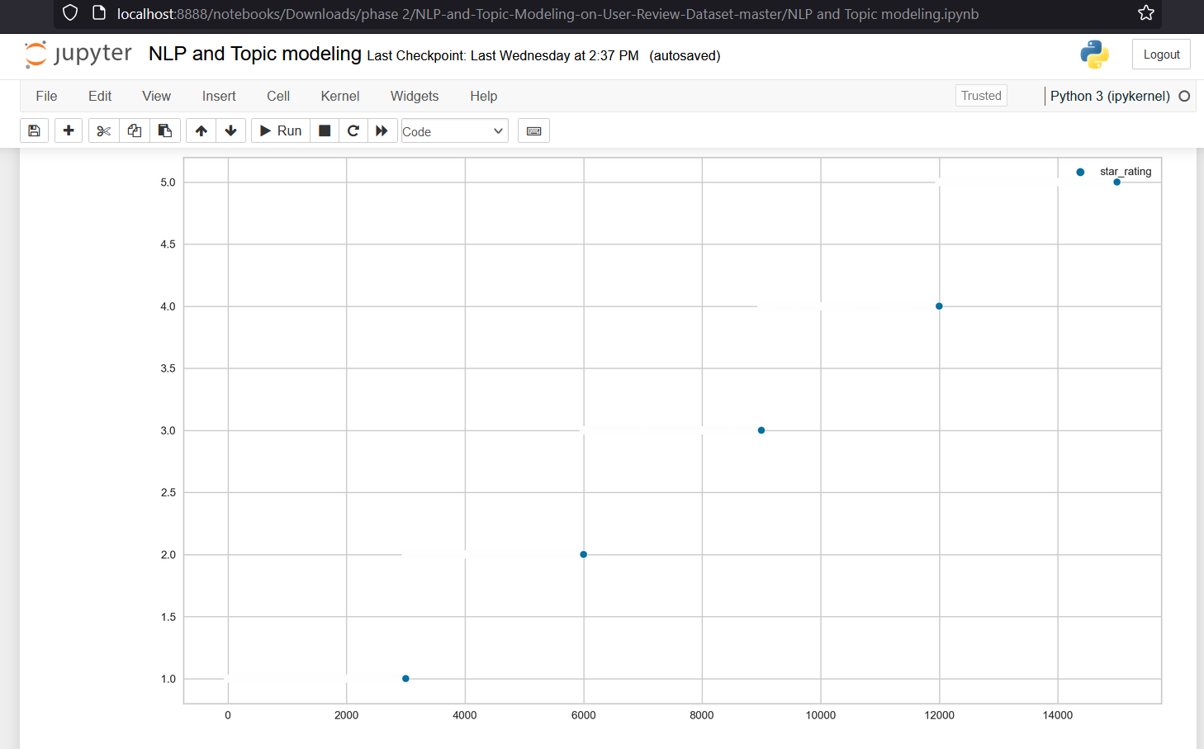

Slide 16
CONCLUSION:
Topic models have an important role in computer science for text mining. In Topic modeling, a topic is a list of words that occur in statistically significant methods. A text can be an email, a book chapter, a blog posts, a journal article and any kind of unstructured text. Topic models cannot understand the means and concepts of words in text documents for topic modeling. Instead, they suppose that any part of the text is combined by selecting words from probable baskets of words where each basket corresponds to a topic. The tool goes via this process over and over again until it stays on the most probable distribution of words into baskets which call topics. Topic modeling can provide a useful view of a large collection in terms of the collection as a whole, the individual documents, and the relationships between the documents. In this paper, we investigated scholarly articles highly related to Topic Modeling based on LDA in various science.

Slide 17
REFERENCES:
1.Blei, D. M., Ng, A. Y., & Jordan, M. I. (2003). Latent Dirichlet allocation. Journal of Machine Learning Research, 3(Jan), 993–1022.
2. Griffiths, T. L., & Steyvers, M. (2004). Finding scientific topics. Proceedings of the National Academy of Sciences, 101(Suppl 1), 5228–5235.
3. Mimno, D., McCallum, A., & Boyd-Graber, J. (2011). Topic modeling in digital libraries. ACM Transactions on Intelligent Systems and Technology, 2(2), 1–39.
4. Newman, D., Asuncion, A., Smyth, P., & Welling, M. (2009). Distributed Algorithms for Topic Models. The Journal of Machine Learning Research, 10, 1801–1828.
5. Steyvers, M., & Griffiths, T. (2007). Probabilistic topic models. Handbook of latent semantic analysis, 424–440.

Slide 18
THANK YOU

